Slide 1
Age and sex differences heart disease
Y Does X Make A Difference
Professor of the Department internal diseases Liskova Yu.V.

Slide 2
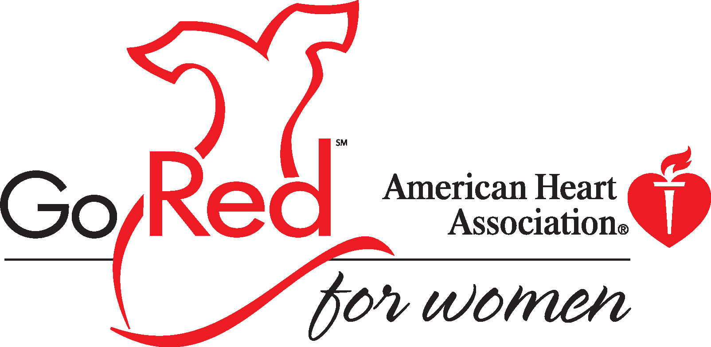
Notes:
Welcome participants and introduce yourself.
If applicable, share your personal connection to heart disease and stroke and why you are passionate about educating women about heart disease.
Ask participants if they have a personal story that they would like to share.

Slide 3
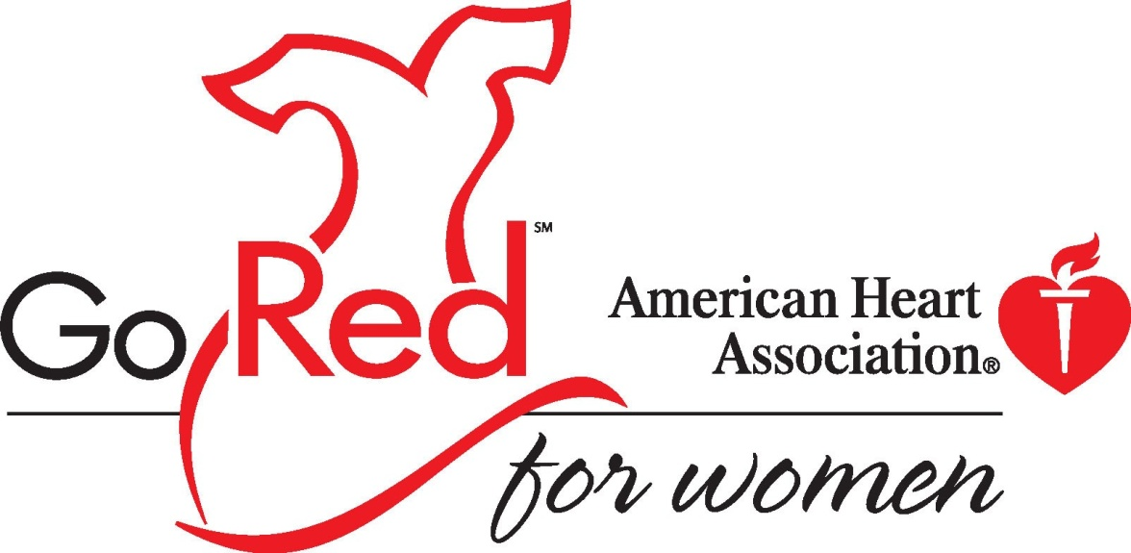
Go Red For Women
This campaign helps women discover unique lifesaving power by learning about heart disease and stroke and taking positive action to reduce their risk
Notes:
Go Red For Women is the American Heart Association’s campaign to help raise women’s awareness of their risk for heart disease and stroke. The initiative encourages women to take charge of their heart health by making it a top priority so they can live longer, healthier lives.

Slide 4
What’s Cardiovascular Disease?
CVD is heart and blood vessel diseases — diseases that affect the circulatory system.
Notes:
We’re here today to talk about a very important issue — women and heart disease. To be more medically precise, we should say “women and cardiovascular disease.” Cardiovascular diseases are heart and blood vessel diseases — in other words, diseases that affect the circulatory system.

Slide 5
Examples
Coronary heart disease (heart attack)
Cerebrovascular disease (stroke and TIA)
High blood pressure
Congestive heart failure
Congenital cardiovascular defects
Peripheral vascular disease
Notes:
There are lots of cardiovascular diseases. This shows some you have probably heard of.
Millions of Americans suffer and die from these diseases. And if you think only men get these diseases, you’re wrong. Dead wrong.

Slide 6
What Women Don’t Know
Coronary heart disease rates in women rise 2-3 times after menopause
Blacks are at higher risk than whites
1 of 3 Hispanic females dies of diseases of the heart and stroke
Notes:
Heart disease is a threat to all women. Older women and African Americans are particularly at risk, as you can see here. The prevalence of CVD in black females is nearly 40 percent, compared to less than 24 percent in white females.

Slide 7
CVD Claims 500,000 Women’s Lives Every Year
CVD — kills more women than the next 7 causes of death combined
Breast cancer — kills 1 in 30 women
CVD — kills 1 of every 2.5 women
Notes:
Cardiovascular diseases are the No. 1 killer of women. Each year they claim the lives of about half a million women. That’s a life each minute, and more lives than the next seven causes of death combined… including all forms of cancer.
How many of you here knew that, statistically speaking, you’re more likely to die from a cardiovascular disease than anything else? Raise your hands.
(If many raise their hands) That’s good. It shows you know more about this problem than most women do.
(If only a few raise their hands) Don’t be embarrassed. Most women are like you. But when you leave here, you’ll know a lot more about women and heart disease.

Slide 8
Women, Heart Disease and Stroke
Heart disease is women’s No. 1 killer
Stroke is women’s No. 3 killer
Notes:
Diseases of the heart and stroke are the No. 1 and No. 3 killers of women over the age of 25. Heart disease and stroke are both cardiovascular diseases, but you can see that if you take them separately, they are two of the top three causes of death for women. Number two is all forms of cancer.

Slide 9
Overview
The scope of the problem
Symptoms
Risk factors
Prevention, diagnosis, and treatment
Pearls from the 2016 ACC Heart of Women’s Health course

Slide 10
The Scope of the Problem
Heart disease is the biggest killer of women
Cardiovascular disease is BY FAR the biggest killer of women
  Roughly 401,000 deaths/year from CVD (vs. 386,000 men)
  176,255 deaths/year from CAD
  Vs 39,520 deaths from breast cancer

Slide 11
The Scope of the Problem
One woman dies every minute from cardiovascular disease in the U.S.!

Slide 12
The Scope of the Problem
CVD accounts for a third of all female deaths
Maryland ranks 33rd in death rate due to CVD, 40th in death rate due to CAD
CVD and CAD disproportionately affect African-American and Latina women

Slide 13
The Scope of the Problem
Women are roughly 10 yrs older than men when they present, and have more co-morbidities
Young women also develop CAD and have a worse prognosis than men
Women are more likely to wait before presenting to medical attention

Slide 14
The Scope of the Problem
Women are referred less often for appropriate testing or treatment
Women with MI are more likely to have complications and increased mortality
Fewer women have been included in studies, so there’s less data

Slide 15
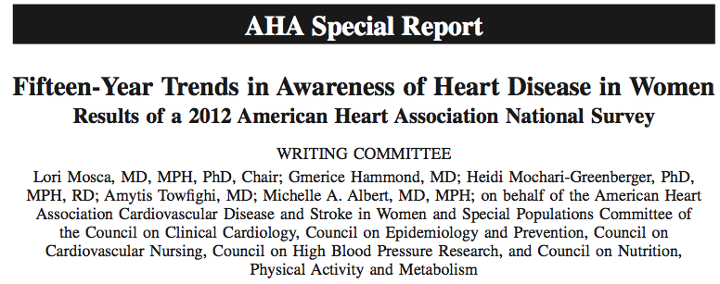
Awareness is lacking!

Slide 16
Awareness is lacking!
~2500 women > 25 y.o. surveyed
Between 1997-2012, awareness among whole study population nearly doubled: 30%→56%
Still low in minorities:
  Blacks: 36%
  Hispanics: 34%

Slide 17
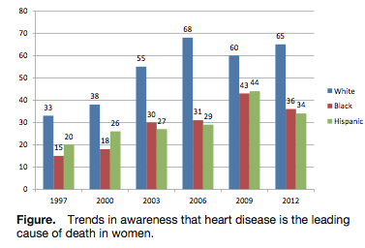
Awareness

Slide 18
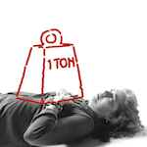

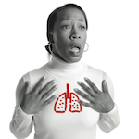

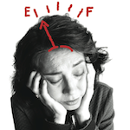
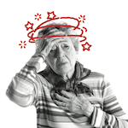
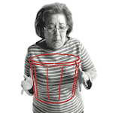
What are the symptoms?
Chest pain or discomfort
Unusual upper body discomfort
Shortness of breath
Breaking out in a cold sweat
Unusual or unexplained fatigue (tiredness)
Light-headedness or sudden dizziness
Nausea (feeling sick to the stomach)

Slide 19
Symptoms in women with MI
Study of 515 women with MI
  Chest pain absent in 43%
  Most common symptom:
    Dyspnea in 58%
    Weakness in 55%
    Fatigue in 43%
  Prodrome:
    Fatigue in 71%
    Sleep disturbance (48%), dyspnea (42%)

Slide 20
Symptoms in women with MI
Over 1,000,000 men and women in NRMI registry, 1994-2006 (481,581 women)
  42% of women presented without Chest pain (vs. 31% of men)
  Higher in-hospital mortality in women (14.6%) than in men (10.3%)
  Younger women without chest pain were at the highest risk

Slide 21
Symptoms in women with MI
These women who presented without Chest pain were sicker and fared worse:
  More had diabetes mellitus (DM)
  Later presentation
  More Killip III/IV
  More NSTEMI
  Less timely therapies
  Less antiplatelet meds, heparin, BB

Slide 22
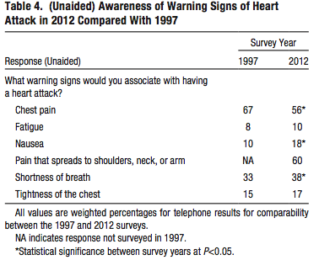
Awareness

Slide 23
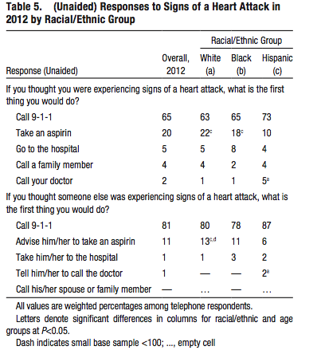
Awareness

Slide 24
Symptoms in women with MI
Sudden cardiac death
  Higher rates in men
  However, a significantly higher percentage of women who have SCD had no prior symptoms! (63% vs. 44%)

Slide 25
Risk Factors
Age over 55
Dyslipidemia: high LDL and/or low HDL
Family hx of premature CAD
  First degree male < 55, female <65
Diabetes
Smoking
Hypertension
Peripheral arterial disease

Slide 26
Risk factors
Menopause
Obesity
High triglycerides
Metabolic syndrome
Sedentary lifestyle
Collagen vascular disease/autoimmune disease
CKD

Slide 27
Risk factors
Pregnancy-related
  Pre-eclampsia, eclampsia
  Gestational diabetes
  Stillbirth
  Miscarriages, esp. multiple
Hx of cancer treatments (XRT)
Depression and stress
Hx of trauma or abuse

Slide 28
Relationship between early menopause and accelerated CVD?
Traditional Paradigm:
Menopause
Increasing Risk of CVD
Minimal or no CVD Risk
Alternative Paradigm:
Increasing Risk of CVD
Menopause
Notes:
The classic paradigm, shown in the figure above, suggests that menopause is a physiologic phenomenon independent of underlying cardiovascular disease. In this model, the reduction in estrogen at the time of menopause results in loss of a protective hormone and the accelerating development of cardiovascular disease.
Increasingly, though, we are learning that the picture is not simple. It turns out that many behaviors and risks that are known to increase CVD (like smoking), will lead to an early menopause. The ovaries are highly vascular organs and it seems likely that the development of CVD likely impact the timing of menopause.
So it seems far more likely that cardiovascular risk is a lifelong process occurring in the background and which may influence and lead to an earlier menopause, which, when it happens may feed back and further increase cardiovascular risk.

Slide 29
Which risk factors are more predictive in women?
Low HDL is more predictive than high LDL
Lp (a) can be more predictive in younger women
TG can be more predictive in older women, especially if >400 mg/dL

Slide 30
Why We Need Go Red For Women
Unhealthy Cholesterol Levels
Women age 20 and older with blood cholesterol levels of 200 mg/dL or higher:
White females — 54%
Black females — 46%
Mexican-American females — 45%
Notes:
High cholesterol is another cardiovascular risk factor. In 2001, 51 percent of American females had cholesterol levels over 200. That’s 55.5 million women.
Cholesterol is a soft, fat-like substance found in the blood and in all the body’s cells. It’s an important part of a healthy body. A high cholesterol level is bad because cholesterol can build up with other substances in the inner walls of arteries. This buildup, called plaque, may narrow the artery and reduce blood flow. Plaques that rupture often cause blood clots to form, which can totally block blood flow in the artery.
If a clot blocks a blood vessel that feeds the heart, it causes a heart attack. If it blocks a blood vessel that feeds the brain, it causes a stroke.

Slide 31
Do You Know Your Total Cholesterol Numbers?
Less than 200 mg/dL — Desirable (lower risk)
200–239 mg/dL — Borderline high (higher risk)
240 mg/dL and above — High blood cholesterol, more than twice the risk of desirable level
Note: Cholesterol levels are measured in milligrams (mg) of cholesterol per deciliter (dL) of blood.
Notes:
A high level of cholesterol in the blood is a risk factor for coronary heart disease, heart attack and stroke. Borderline-high cholesterol is defined as 200 to 239 mg/dL or higher. High cholesterol is 240 or higher.
LDL and HDL cholesterol are also important. LDL is the bad form of cholesterol, so lower numbers are better. HDL is the good form, so you want more of it. Your doctor can tell you your LDL goal. Your HDL cholesterol should be above 50.
Some ways to have a healthy cholesterol level include:
Watch your caloric intake by eating a wide variety of foods low in
saturated fat and cholesterol,
maintain a healthy weight, and
get regular physical activity.

Slide 32
Which risk factors are more predictive in women?
Diabetes: almost double the risk of fatal CAD
Smoking:
  associated with 50% of all coronary events in women
  Risk elevated even with minimal use

Slide 33
Why Is Diabetes Bad?
66-75% of people with diabetes die of some form of CVD
Diabetes lowers “good” cholesterol, and raises “bad” cholesterol and triglyceride levels
Many people with diabetes also have high blood pressure and are overweight
Notes:
Diabetes is serious as you can see here. Adults with diabetes have heart disease death rates about two to four times higher than those for adults without diabetes. In fact, from two-thirds to three-quarters of people with diabetes die of some form of cardiovascular disease.
If you’re middle-aged or older, physically inactive and overweight, you’re more likely to develop diabetes.

Slide 34
Why We Need Go Red For Women
Smoking
Smoking is the single most
preventable cause of death in the US
21 percent of American women age 18
and older smoke — 22.6 million women
Notes:
Smoking is the single most preventable cause of death in the United States today. About 440,000 Americans die every year from smoking-related illnesses. About 35,000 are nonsmokers killed by coronary heart disease from breathing environmental tobacco smoke.
Tobacco smoke is a risk factor for heart disease and stroke because it causes plaque to build up in blood vessels and may trigger blood clotting. In 2001, 21 percent of American females age 18 and older smoked. That’s 22.6 million American women.

Slide 35
Effect of smoking
Women who smoke have a six-fold increased risk of MI (vs. 3x in men)
Risk was higher for women smokers than men regardless of age

Slide 36
Smoking
If you don’t smoke, don’t start
If you smoke, quit
Avoid others’ tobacco smoke
Notes:
Obviously, the best thing to do is never to start smoking and to avoid other people’s tobacco smoke. If you smoke, you need to summon the strength to quit. It won’t be easy, but you can do it, because millions of other people just like you have done it.
The good news is that when you stop smoking — no matter how long or how much you’ve smoked — your risk of heart disease and stroke starts to drop. In time, your risk will be about the same as if you’d never smoked. You’ll also feel better, smell better and find that foods taste better.

Slide 37
Reproductive
Pregnancy-related
  “failed stress test:
  Pre-eclampsia – 3.8x more likely to develop DM, 11.6x more likely to develop HTN requiring rx
  Gestational DM: up to 70% develop DM within 5 years
Menopause

Slide 38
Why We Need Go Red For Women
High Blood Pressure (HBP)…
The Silent Killer
Women age 20 and older who have HBP:
White females — 30%
Black/African-American females — 45%
Mexican-American females — 30%
Notes:
High blood pressure is often called the “silent killer” because usually it has no symptoms. In 2001, 32 percent of American females had high blood pressure.
High blood pressure forces your heart to work harder than normal. That makes it and your arteries more likely to be injured — which raises your risk for heart attack and stroke.
Chances of high blood pressure increase if you have a family history of high blood pressure, are 20 pounds or more over a healthy weight, or have reached the age of menopause.
The only way to know if your blood pressure is high is to have it measured at least every two years.

Slide 39

Physical Inactivity
Increases heart disease and stroke risk
30 minutes or more of activity on most or all days of the week helps reduce risk by controlling blood cholesterol, diabetes and obesity and helping to lower HBP
Notes:
Regular, moderate-to-vigorous exercise improves cardiovascular fitness and helps reduce your risk of heart disease and stroke. The American Heart Association recommends at least 30 minutes of physical activity on most or all days of the week.

Slide 40
Why We Need Go Red For Women
Obesity / Overweight
Overweight/obese women age 20 and older:
White females — 57%
Black females — 77%
Mexican-American females — 72%
Notes:
Each year an estimated 300,000 U.S. adults die of causes related to obesity.
If you have too much body fat — especially if a lot of it is in your waist area — you’re at higher risk for heart disease even if you don’t have other risk factors. In 2001, 62 percent of American females were overweight or obese.

Slide 41
The Three Paradoxes
1. Women have a higher prevalence of angina compared to men, yet have an overall lower prevalence of atherosclerosis and obstructive coronary artery disease
2. Symptomatic women undergoing coronary angiography have less extensive and severe CAD, despite being older with a greater risk factor burden, compared to men
3. Despite relatively less CAD, women have a more adverse prognosis compared to men
Notes:
These findings force clinicians to approach coronary artery disease from a different perspective based on the sex of the patient.

Slide 42
Gender and MI Triggers
Women reported emotional stress prior to MI
  Marital stress was reported to be more problematic in women
  Work stress was more problematic for men
Men reported heavy physical activity prior to MI

Slide 43
Ischemia symptoms in women: “atypical”
fatigue
right or left arm and shoulder pain
indigestion
epigastric pain
neck pain
syncope
nausea
abdominal pain
dyspnea
dizziness
palpitations
interscapular pain
weakness
vomiting
throat and jaw pain
asymptomatic
Notes:
“Typical” angina refers to symptoms commonly experienced during myocardial ischemia: squeezing chest pain, chest heaviness, radiation of pain to the left arm, and diaphoresis. Since acute myocardial ischemia was initially described in men, these symptoms were assigned to women. While these symptoms are very common in women, NHLBI conference declared that 65% of women with CAD did not have typical angina. “Atypical” symptoms may be present without chest discomfort. Of the symptoms noted on this slide, only throat and jaw pain occurred much more commonly in women than men.
The variance of these symptoms from expected contributes to the underdiagnosis or misdiagnosis in women.

Slide 44
Differences in Symptoms: Hypotheses of origin
Parasympathetic nerves innervate the posterior and inferior surfaces of the heart
Women and men are more likely to have right dominant coronary systems
Women have a predominance of parasympathetic influence on heart rate regulation
Theory: ischemia of those areas stimulates the vagus nerve
  causes discomfort in locations also innervated by the vagus nerve
Notes:
The reasons for sex differences in the symptoms of myocardial ischemia remain a mystery. It is believed that the anatomic differences between the sexes in the placement of parasympathetic nerves may reveal insight. The literature suggests that there is no sex difference in coronary artery dominance (Gawlikowska-Sroka. Analysis of the influence of heart size and gender on coronary circulation type. Folia Morphol. Vol 69, No. 1, pp.35-41.)
Hypotheses: right dom in women- small study

Slide 45
Relative Risk (95% CI) for mortality in subjects with hypertension, diabetes, or both adjusted for age, center, BMI, smoking and cholesterol.
DECODE study
 | Men | Women
CV Disease
Normal | 1.00 | 1.00
Hypertension | 1.45 (1.23-1.72) | 1.89 (1.34-2.66)
Diabetes | 2.06 (1.45-2.93) | 2.36 (1.29-4.31)
Diabetes and Hypertension | 2.32 (1.83-2.94) | 4.57 (3.06-6.82)
All Causes
Normal | 1.00 | 1.00
Hypertension | 1.25 (1.12-1.39) | 1.10 (0.91-1.33)
Diabetes | 1.87 (1.48-2.36) | 1.64 (1.14-2.36)
Diabetes and Hypertension | 1.97 (1.68-2.32) | 2.22 (1.74-2.83)
Notes:
“The Decode study has shown that diabetes and hypertension have a greater importance of determining the cardiovascular risk in women than in men as the association of the two risk factors doubles the attributable risk for CVD in women compared to men.”
Hu, G. Plasma insulin and cardiovascular mortality in non-diabetic European men and women: a meta-analysis of data from eleven prospective studies. Diabetologia (2004) 47: 1245-1256. (The above sentence is from Lombardi, M. Gender-specific aspects of treatment of cardiovascular risk factors in primary and secondary prevention. Fundamental & Clinical Pharmacology 24 (2010):699-705.

Slide 46
Atherosclerosis Risk Factors Unique to Women
  Climacteric symptoms- peri and early post menopausal symptoms are not associated with cardiovascular disease
    Persistent or late-onset hot flashes are associated with heart disease
Hypertensive events during pregnancy
Hyperglycemic events during pregnancy
Acceleration of the prevalence of heart disease after menopause
Notes:
Develop graphic Vasomotor symptoms, or hot flashes, experienced during and after the menopause transition have been associated with more aggressive atherosclerosis. Fraser’s data shows that women who experience hypertensive events during pregnancy experience a relative risk of for cardiovascular events compared to women without hypertensive events. Levy states post-menopausally sustained hypertension is frequently preceeded by hypertension, eclampsia, or preeclampsia during pregnancy (JAMA 275, 1557- 1562 (1996) that Women who experience hyperglycemic events during pregnancy experience a relative risk of for future cardiovascular events compared to women without hyperglycemic events during pregnancy. These findings introduce a novel topic for preventative counseling to women regarding cardiovascular risks:

Slide 47
Other Risk Factors Under investigation
  Systemic autoimmune disease greatly increases risk of cardiovascular disease
  Higher prevalence of autoimmune disease in women
Notes:
Endocrine meeting 2012 sz

Slide 48
Differences in Coronary Vascular Plaque Pathology
Female
Male
Continuous endothelial plaque deposition
Outward remodeling
Present in small distal arteries
More endothelial dysfunction
Localized endothelial plaque deposition
Invades lumen diameter
Present in medium-sized arteries
Notes:
Need graphic Outward remodeling describes plaque which expands the outer diameter of the vessel, rather than decreasing the lumen diameter.
Testing endothelial dysfunction is best done by invasive coronary reactivity testing for measurement of both endothelial- and nonendothelial dependent reactivity, according to Dr. Bairey Merz in Women and Ischemic Heart Disease. JACC: Cardiovascular Imaging Vol 4, No. 1, 2011.

Slide 49
Diagnosis
Treadmill stress testing
Nuclear stress testing
Stress echo
CT calcium score
Coronary CTA
Cardiac catheterization with coronary angiography

Slide 50
Diagnosis
Exercise electrocardiogram (EKG) is the gold standard for diagnosis of cardiovascular disease in men.
Women tend to have higher ejection fractions at rest and approximately thirty percent of women, when exercising, do not increase their ejection fraction.

Slide 51
Diagnosis
To exclude cardiovascular disease in women, they must have a normal resting EKG and no risk factors for cardiovascular disease.

Slide 52
Diagnosis
Women have higher mortality rates due to arrhythmias than men.
Women have fatal arrhythmias as the first indicator of cardiovascular disease more often than men.

Slide 53
Diagnosis
Women have longer rate-corrected QT intervals than men.
It has been determined that males who have long QT intervals have a strong correlation with fatality post myocardial infarction, so there is an indication that since women have longer QT intervals, they may be at an increased risk for sudden cardiac failure. (Malloy, 1999)

Slide 54
Differences in Ischemia Testing for non-obstructive disease
Less effective
More effective
Treadmill
Percutaneous Coronary Angiography
CT angiogram
Nuclear stress echo
Cardiac Magnetic Resonance Imaging
Notes:
Women presented twice as frequently with open coronary arteries than men when experiencing myocardial infarctions or unstable angina.
CT angiogram- less revealing for younger women without obstructive lesions. CTA was a strong predictor of cardiovascular events in female patients aged >60 years. In contrast, however, CTA provided limited prognostic value in females younger than 60 years (Yiu,K. Age- and gender-specific differences in the prognostic value of CT coronary angiography. Heart 2012;98:232-237.) Insert figure 4.

Slide 55
Angiography Differences
Of women with chest pain or an abnormal stress test, only 40% had flow-limiting stenosis on angiography
Women are more likely to have single vessel disease
Sex differences in vascular obstructions on angiography disappear with advancing age
Notes:
Animation of evolution of continuous endothelial plaque to peaks and valleys

Slide 56
The triad of microvascular dysfunction
Angina
Abnormal stress testing
No obstruction on angiography
Notes:
Dr. Arang Samim summarizes the triad of microvascular dysfunction, which is experienced more often in women: angina with normal stress testing and clean coronary arteries on percutaneous coronary angiography.

Slide 57
Coronary Differences
Anatomical differences: Women have smaller coronary arteries
Women may experience endothelial dysfunction more commonly
  Abnormal stress test
Notes:
Endothelial dysfunction refers to the inability of the endothelium to produce nitric oxide resulting in poor vascular relaxation. Research to definitively link vascular dysfunction and ischemia symptoms are underway.
Picture male vs female coronary arteries

Slide 58
Sex Differences in Plaque Disturbance
Women
Men
Superficial plaque erosion with thrombus formation
Plaque rupture
Notes:
Insert figure: Sex differences in atherosclerotic plaque disruption. Circulation 1998:97:2110-2116. Kruk, M. in Am J Cardiology 2007:100:185-189 showed by intravascular ultrasound that occluding lesions in women revealed more thrombus at plaque rupture.

Slide 59
Biomarkers in Acute Coronary Syndrome
Women
Men
CRP
BNP
Troponin
Creatine kinase
Notes:
TACTICS TIMI-18
Women showed markers indicating inflammation and heart failure, where men showed markers indicating plaque rupture

Slide 60
Comparisons of revascularization procedures
Equally effective when performed in similar time frames
  Percutaneous coronary intervention
  Coronary Artery Bypass Grafting
Women tend to bleed more often with antiplatelet therapy
Women have greater mortality after CABG
Notes:
Procedural success in percutaneous coronary intervention is similar in men and women, although women tend to experience more bleeding complications. Women tended to have better quality of life scores after fibrinolysis, and men tended to have better quality of life scores after PCI.

Slide 61
Differences in Ischemia Mortality
Women without chest pain have higher in-hospital mortality
  Especially under 65 years of age in the 30 days after hospitalization
Higher rates of in-hospital mortality, death, or myocardial (re)infarction
More frequent hospitalizations with nonobstructive disease
Notes:
Women are more likely to suffer inpatient complications of mechanical complications, pulmonary edema, and cardiogenic shock. Women commonly carry more comorbid conditions, receive fewer revascularization procedures, and less frequent use of secondary prevention therapies. Young women suffer the greatest mortality after an MI than age-matched men.

Slide 62
Sex-Specific Recommendations by ACC/AHA practice guidelines
Women with high-risk features, recommendations for invasive strategy are similar to men
Women with low-risk features, initial non-invasive strategy is recommended
Notes:
The presence of at least one positive biomarker separates the two groups.
*Check new guidelines for update

Slide 63
Sex Differences in Risk Factor Impact After Infarction
Diabetic women are 3x more likely to die after a cardiac event than diabetic men
Women who smoke experience more complications in the 6 months following an MI
  Repeat myocardial infarction
  Heart-related hospitalization
  Revascularization procedure

Slide 64
Differences in evidence for secondary prevention therapy
Statin- equally effective
Aspirin- equally effective
Nitrates- equally effective
ACE inhibitors- equally effective
Beta blockers- equally effective
Aldosterone inhibitors- equally effective
GPIIb/IIIIa inhibitor- may be less effective in women
Notes:
While secondary prevention therapies appear to be equally effective in both sexes, female patients are less likely to receive them.

Slide 65
Treatment for Microvascular Coronary Dysfunction
Statins, angiotensin-converting enzyme inhibitors, and aspirin
B-blockers, calcium channel blockers, nitrates
Notes:
Statins improve endothelial function and lower C-reactive protein, and ACE- inhibitors improve coronary flow reserve in patients with microvascular angina. The non-specific B-blockers, such as carvedilol and nebivolol, may be preferred due to their beta and alpha blocking activity.

Slide 66
Emotional Impact of MI on the Sexes
Women are less likely to involve spouses in the recovery process
Women suffer from depression and anxiety after MI than men
Receiving health information from practitioners resulted in less depression
Sex after MI occurs less often in almost half of men and nearly 60% of women
Notes:
Women desired more information from their doctors after an acute ischemic coronary event, particularly about angina and hypertension, according to a study by Stewart. Patients who reported receiving more information reported less depressive symptomatology and greater preventative health behaviors.

Slide 67
Estrogen therapy after plaque is present conveys no benefit to the endothelium
Estrogen therapy for secondary prevention of coronary artery disease is discouraged

Slide 68
Stress Testing
ETT only (lower than in men)
  61% and 70%
Stress Nuclear (similar in men)
  78% and 64%
Stress Echo (similar in men)
  86% and 79%

Slide 69
Coronary CTA
ROMICAT trial
  Women had greater reduction in LOS, lower admission rates, lower radiation doses
  More normal studies, less obstructive dz

Slide 70
Diagnosis
Women less likely to be referred for further evaluation if they have a positive stress test
  Higher incidence of MI or death in these patients

Slide 71
Risk Factors/Prevention
The Multiplier Effect
  1 risk factor doubles your risk
  2 risk factors quadruple your risk
  3 or more risk factors can increase your risk more
  than tenfold
By doing just 4 things – eating right, being physically active, not smoking, and keeping a healthy weight – you can lower your risk of heart disease by as much as 82 percent

Slide 72
Treatment/Prevention
All women
  Exercise
  Quit smoking
  Healthy diet
  BMI <25, waist circumference <35 in.
  Treat risk factors: HTN, DM, dyslipidemia
  ASA – look at risk/benefit ratio
  Treat depression

Slide 73
Treatment/Prevention
Increasing awareness
Screening

Slide 74
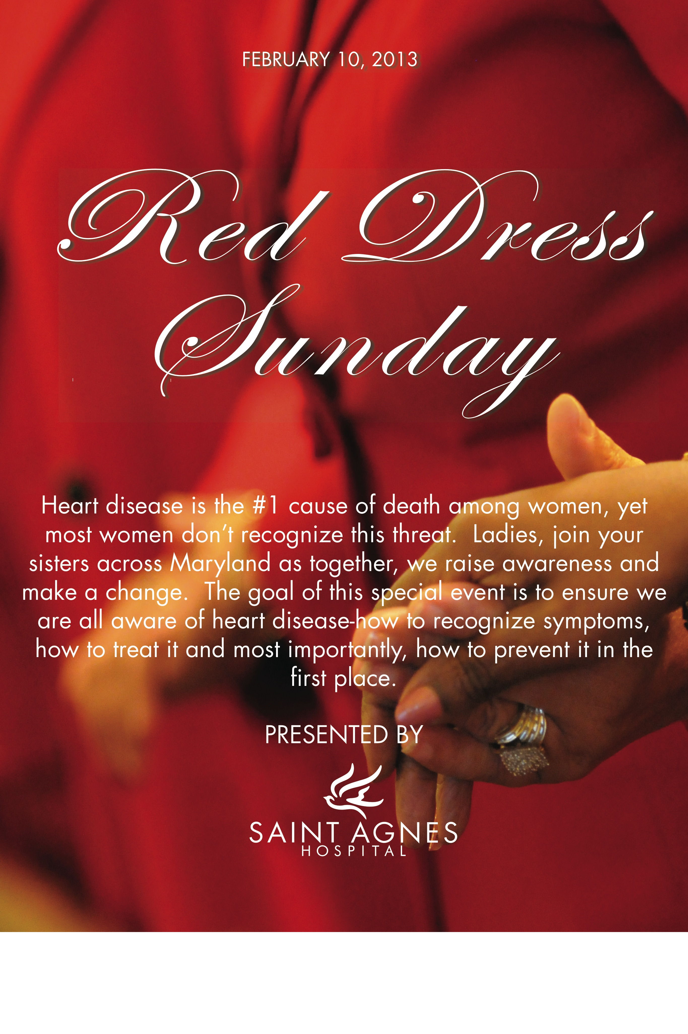
How are we getting the word out?

Slide 75
How are we getting the word out?

Slide 76
Saint Agnes Women’s Heart Center
“60 minutes for $60”
60 minutes of screening and education
Personal risk assessment
EKG
Blood work: lipid profile, hemoglobin A1c

Slide 77
Treatment/Prevention
Lipids: New guidelines
  Different approach: moderate or high intensity statin rather for different risk categories rather than treatment to targets
  Overall risk
  Patient centered care
  Limited role for non-statin rx

Slide 78
Treatment/Prevention
Lipids: New guidelines
  4 categories:
    Clinical ASCVD, no HF or ESRD on HD
    Ages 40-75 with DM and LDL 70-189
    LDL >190
    Ages 40-75, LDL 70-189, estimated 10-year risk of 7.5% or greater
  New risk calculator: Pooled Cohort Equations for ASCVD risk predictionshttp://www.cardiosource.org/en/Science-And-Quality/Practice-Guidelines-and-Quality-Standards/2013-Prevention-Guideline-Tools.aspx?w_nav=Search&WT.oss=new risk calculator&WT.oss_r=3056&

Slide 79
Lipid therapy
New risk calculator
  Heavily driven by age, also includes ethnicity/race, BP, cholesterol, current tobacco use and DM
  65 yo M or 71 yo F with optimal RF has >7.5% 10 year risk of ASCVD
  If uncertain, can take into consideration other factors:
    Family hx
    CRP>2
    Calcium score >300 or >75%
    Abnormal ABI (<0.9)

Slide 80
Lipid therapy
New guidelines
  No clear role for CKD, apoB, albuminuria, cardiorespiratory fitness, CIMT
  Lifestyle modifications
    Diet high in fruits and vegetables
    Keep sat fat <5-6%, minimize trans fat
    Exercise: 3-4 sessions/week, 40 minutes per session to lower LDL

Slide 81
Treatment/Prevention
High risk women
  Dyslipidemia (better secondary prevention data: 4S, CARE, HPS, PROVE-IT)
  Aspirin
  HTN
  No role for vitamins or HRT

Slide 82
Treatment in ACS or acute MI
Medical therapy
  Aspirin, beta blockers, ACE-inhibitors
  Statins

Slide 83
Treatment
While the primary benefit of digoxin is to decrease hospitalizations, women have benefited less than men.
Women who had stable heart failure and were taking digoxin had higher death rates than men.

Slide 84
Treatment
Women had no decrease in cardiovascular events when taking an ACE inhibitor, whereas men had a 17% reduction in cardiovascular events when taking an ACE inhibitor.

Slide 85
Treatment
Women also experience more side effects due to an ACE inhibitor.
Women have more side effects from anti-hypertensive drugs than men, including hyponatremia and hypokalemia.

Slide 86
Treatment
Thrombolytics such as tissue plasminogen activator, have been proven beneficial in both men and women but there is an increased risk of intracerebral hemorrhage in women, possibly because of inappropriate dosing due to smaller body size in women.

Slide 87
Treatment
Streptokinase and t-plasminogen activator was found to have a three-time higher 30-day mortality rate for women than men.
Women probably receive thrombolytic therapy later than men due prolongation of diagnosis.

Slide 88
Thrombolysis
Fibrinolyic therapy in (TIMI)-II
  Higher rates of death and reinfarction in women at 6 weeks and one year
Fibrinolytic therapy in (ExTRACT-TIMI)-25
  Higher incidence of death after reperfusion in women
Notes:
The sex differences in mortality after reperfusion are predominantly explained by baseline differences, including advanced age and greater comorbidity in women, according to Bairey Merz in the Proceedings from the Scientific Symposium: Sex Differences in Cardiovascular Disease and Implications for Therapies. J of Women’s Health Vol 19, No 6, 2010.

Slide 89
Treatment
It has been found that women have smaller hearts than men and, therefore, smaller coronary arteries, which contributes to the more extensive complications that women have when they undergo invasive procedures such as angiography and CABG. (McCormick and Bunting, 2002, Caves 1998)

Slide 90
Treatment
A retrospective study of 345,000 outcomes concering coronary bypass surgery, since 1994 showed that women had a “significantly higher operative mortality rate than equally matched men”. (Malloy, 1999)

Slide 91
Interventional treatment in women
Less likely to be referred
Higher complication rate than in men
  Smaller arteries, more bleeding
But these pts do better than if no intervention
Higher peri-procedural rate of complication but better long-term survival than men

Slide 92
Treatment of ACS, NSTEMI, STEMI
Early invasive strategy for high-risk patients
PCI for STEMI
  Better than fibrinolysis or POBA

Slide 93
Estrogen Replacement: The reality
Estrogen therapy is reasonable for the relief of perimenopausal symptoms if started early and tapered after a few years
Estrogen administered transdermally may be less likely to increase risk of blot clots
Estrogen should not be given to reduce CVD risk
Notes:
So the bottom line is that estrogen probably is safe when given to young women who are perimenopausal either physiologically or by virtue of surgery, and that a few years of treatment is likely safe and beneficial.

Slide 94
Bleeding
Women have more bleeding than men
  Technical factors, medication issues
  RISK-PCI
    Same efficacy as in men
    Higher bleeding
    Higher mortality

Slide 95
Bleeding
Bleeding avoidance strategies
  Transradial approach, closure devices, bivalrudin
  Lower bleeding rates in both sexes
  Higher absolute bleeding rate

Slide 96
Other cardiac causes of chest pain
Women’s ischemic heart disease (syndrome X, microvascular disease)
Myocarditis
  Stress-induced cardiomyopathy
Coronary dissection

Slide 97
Cancer and CV disease
Chemotherapy toxicity: anthracyclines and Herceptin
  Communication and monitoring
  Treatment of baseline risk factors: HTN, DM, CAD and LV dysfxn pts at higher risk
  Older patients
  Combination chemo and higher dose chemo
  Combination with XRT

Slide 98
Cancer and CV disease
Radiation toxicity
  Effects on all parts of the heart
  Most common sign: pericardial effusion
  Increases by 7.4% per gray of xrt dose
  Starts within first 5 yrs after rx, continues for at least 20 years
  Women with baseline cardiac RF at higher risk of events

Slide 99
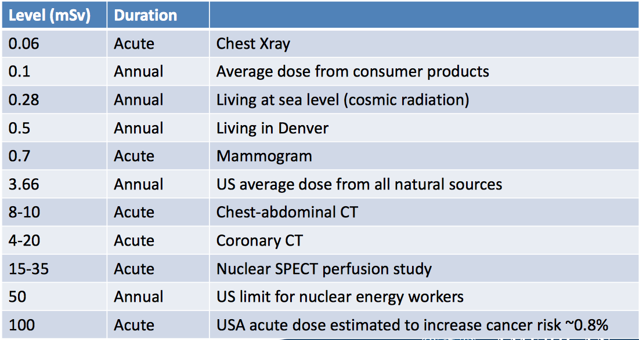
Women and radiation exposure

Slide 100
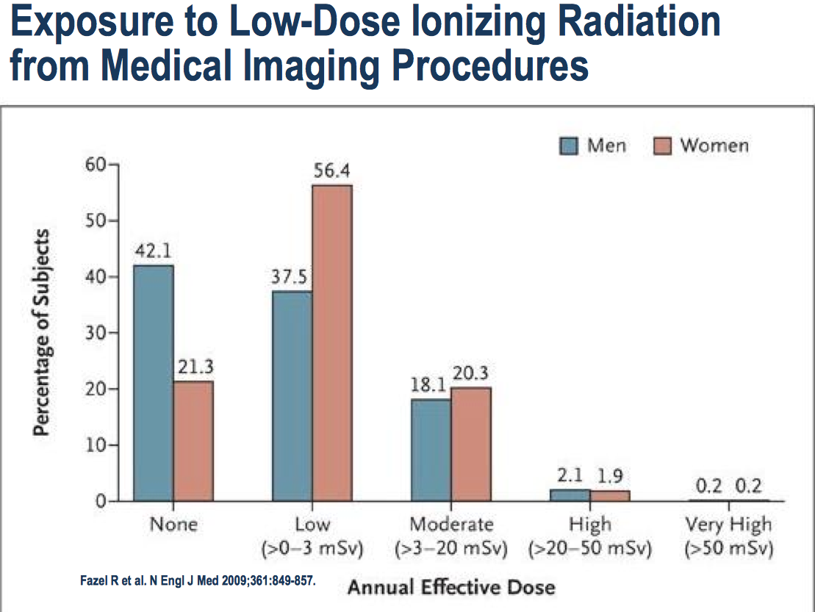
Women and radiation exposure

Slide 101
Take-home points
CAD and CVD are by far the biggest health risks for women
Awareness is still less than it needs to be
Prevention CAN reduce risk
Screening programs are available

Slide 102
Take-home points
Women can present differently, and do worse when they do
Women are referred less often for appropriate testing and treatment
Women can have more complications from treatment, but still fare better than without rx
Special considerations: pregnancy, menopause, comorbidities

Slide 103
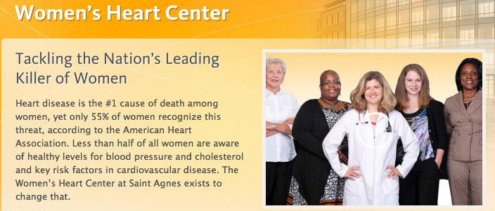
THANK YOU!

